Slide 1
Traditional
Symmetric-Key Ciphers
Dr. B C Dhara
Department of Information Technology
Jadavpur University

Slide 2
Objective of this chapter
Define the terms and the concepts of symmetric key ciphers
Emphasize the two categories of traditional ciphers: substitution and transposition ciphers
Describe the categories of cryptanalysis used to break the symmetric ciphers
Introduce the concepts of the stream ciphers and block ciphers
Discuss some very dominant ciphers used in the past
B C Dhara, Dept. of IT, JU

Slide 3
Different terms of cryptography
plaintext - original message
ciphertext - coded message
cipher - algorithm for transforming plaintext to ciphertext
key - info used in cipher known only to sender/receiver
encipher (encrypt) - converting plaintext to ciphertext
B C Dhara, Dept. of IT, JU

Slide 4
Different terms of cryptography (contd…)
decipher (decrypt) - recovering ciphertext from plaintext
cryptography - study of encryption principles/methods
cryptanalysis (codebreaking) - study of principles/ methods of deciphering ciphertext without knowing key
cryptology - field of both cryptography and cryptanalysis
B C Dhara, Dept. of IT, JU

Slide 5
More Definitions
unconditional security
  no matter how much computer power or time is available, the cipher cannot be broken since the ciphertext provides insufficient information to uniquely determine the corresponding plaintext
  A necessary condition for a symmetric-key encryption scheme to be unconditionally secure is that the key be at least as long as the message
  The one-time pad is an example of an unconditionally secure encryption algorithm
Public-key encryption schemes cannot be unconditionally secure since, given a ciphertext c, the plaintext can in principle be recovered by encrypting all possible plaintexts until c is obtained.
B C Dhara, Dept. of IT, JU

Slide 6
computational security
given limited computing resources (eg time needed for calculations is greater than age of universe), the cipher cannot be broken
B C Dhara, Dept. of IT, JU

Slide 7
Provable security
A cryptographic method is said to be provably secure if the difficulty of defeating it can be shown to be essentially as difficult as solving a well-known and supposedly difficult (typically number-theoretic) problem, such as integer factorization or the computation of discrete logarithms
B C Dhara, Dept. of IT, JU

Slide 8
Brute Force Search
Always possible to simply try every key
Most basic attack, proportional to key size
Assume either know / recognise plaintext
Key Size (bits) | Number of Alternative Keys | Time required at 1 decryption/µs | Time required at 10⁶ decryptions/µs
32 | 2³² = 4.3 × 10⁹ | 2³¹ µs = 35.8 minutes | 2.15 milliseconds
56 | 2⁵⁶ = 7.2 × 10¹⁶ | 2⁵⁵ µs = 1142 years | 10.01 hours
128 | 2¹²⁸ = 3.4 × 10³⁸ | 2¹²⁷ µs = 5.4 × 10²⁴ years | 5.4 × 10¹⁸ years
168 | 2¹⁶⁸ = 3.7 × 10⁵⁰ | 2¹⁶⁷ µs = 5.9 × 10³⁶ years | 5.9 × 10³⁰ years
26 characters (permutation) | 26! = 4 × 10²⁶ | 2 × 10²⁶ µs = 6.4 × 10¹² years | 6.4 × 10⁶ years
B C Dhara, Dept. of IT, JU

Slide 9
Classification of cryptography
Cryptography referred to encryption and decryption of messages using secret keys
  Symmetric-key cryptography
  Asymmetric-key cryptography
B C Dhara, Dept. of IT, JU

Slide 10

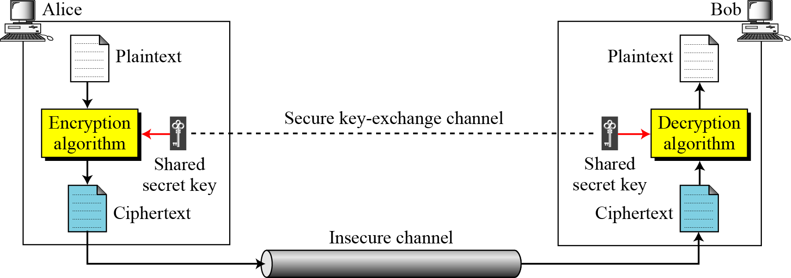
General idea of symmetric cipher
B C Dhara, Dept. of IT, JU

Slide 11
Intro to Cryptography
two requirements for secure use of symmetric encryption:
  a strong encryption algorithm
  a secret key known only to sender / receiver
mathematically have:
  Y = E(K, X)
  X = D(K, Y)
assume encryption algorithm is known
  implies a secure channel to distribute key
B C Dhara, Dept. of IT, JU

Slide 12
Intro to Cryptography (contd…)
We can characterize cryptographic system by:
  type of encryption operations used
    substitution
    transposition
  number of keys used
    single-key or private
    two-key or public
  way in which plaintext is processed
    block
    stream
B C Dhara, Dept. of IT, JU

Slide 13
Symmetric key …
  Plain text P ➔ cipher text C= E_{k}(P) [encryption process]
  ➔ P=D_{k}(C) [decryption process]
  For any arbitrary message ‘x’
  ➔ D_{k}(E_{k}(x)) = E_{k}(D_{k}(x)) = x
Suppose P’= D_{k}(C) = D_{k}(E_{k}(P)) = P
B C Dhara, Dept. of IT, JU

Slide 14
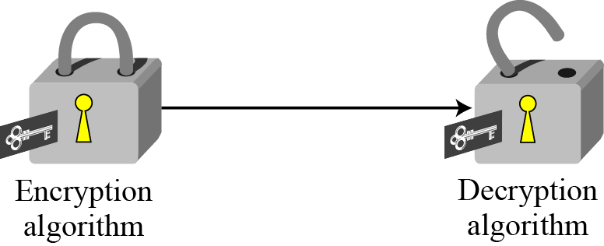
Symmetric key …
Encryption can be thought as locking the message in a box, and
Decryption can be thought as unlocking the box
  In symmetric key system same key is used both for locking and unlocking
B C Dhara, Dept. of IT, JU

Slide 15
Kerckhoff’s Principle
A cipher text would be more secure if we hide both the encryption/decryption algorithm and the secret key
According to Kerckhoff’s principle:
  one should always assume that the adversary, knows the encryption/decryption algorithm. The resistance of the cipher to attack must be based only on the secrecy of the key
B C Dhara, Dept. of IT, JU

Slide 16
Kerckhoff’s Principle (contd…)
Resistance to attack must be on the secrecy of the key
  Guessing key should be so difficult that no need to hide the algorithms
  Key domain should be so large that it makes difficult for an adversary to find the key
B C Dhara, Dept. of IT, JU

Slide 17
Cryptanalysis
Cryptography is the science and art of creating secret codes, cryptanalysis is the science and art of breaking those codes
objective to recover key not just message
  general approaches:
    cryptanalytic attack
    brute-force attack
  if either succeed all key use compromised
B C Dhara, Dept. of IT, JU

Slide 18
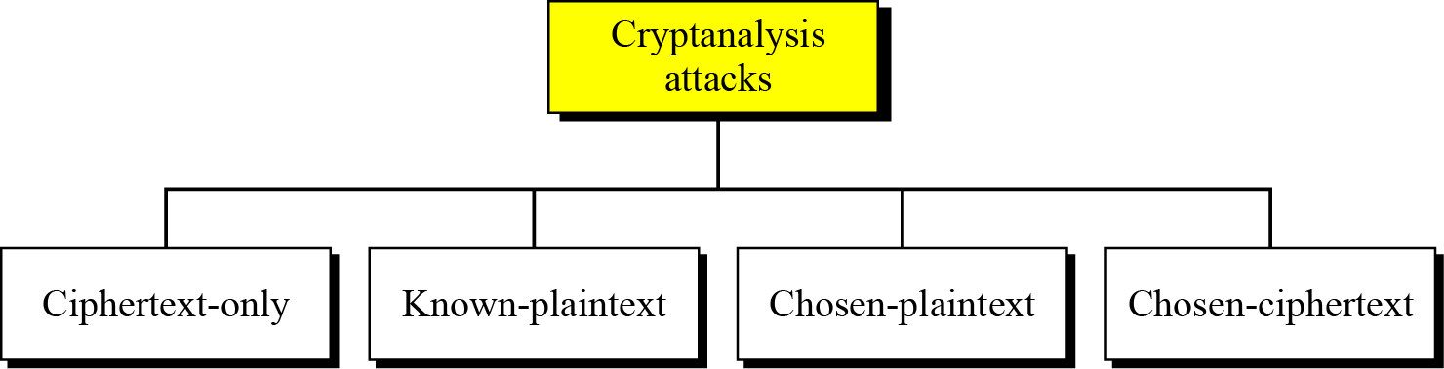
Cryptanalysis attacks
Attacks on encryption schemes
The objective of the following attacks is to systematically recover plaintext from ciphertext, or even more drastically, to deduce the decryption key.
B C Dhara, Dept. of IT, JU

Slide 19
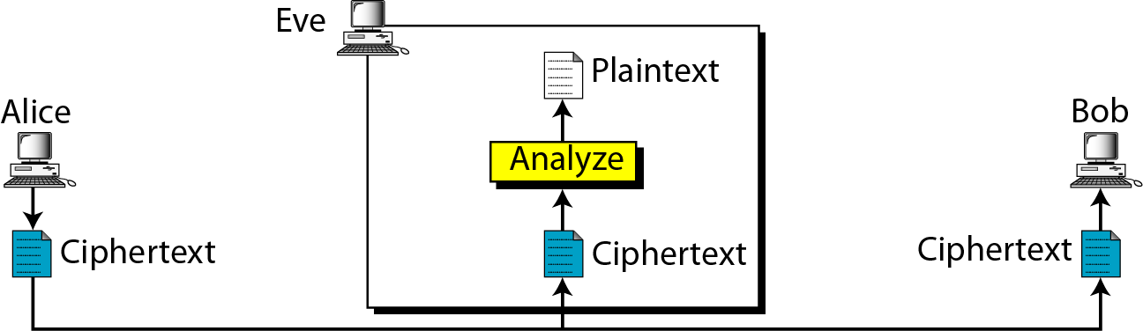
Ciphertext-Only Attack
Attacker has access to some ciphertext
  Tries to find the corresponding key and the plaintext
  This is most probable attack as only ciphertext is needed
  Any encryption scheme vulnerable to this type of attack is considered to be completely insecure.
B C Dhara, Dept. of IT, JU

Slide 20
Common approaches in ciphertext only attack
Brute-force attack
  Decrypt the ciphertext with every possible key until the plaintext makes sense
  To prevent this attack, number of possible keys should be very large
Statistical attack
  Some characteristics of the plaintext language help in statistical attack
  In English, ‘E’ is most frequently used character
    Mostly available character in ciphertext may give ‘E’
B C Dhara, Dept. of IT, JU

Slide 21
Common approaches in ciphertext only attack
Pattern attack
  Some patterns available in ciphertext may help to break the ciphertext
  Try produce ciphertext as random as possible
B C Dhara, Dept. of IT, JU

Slide 22
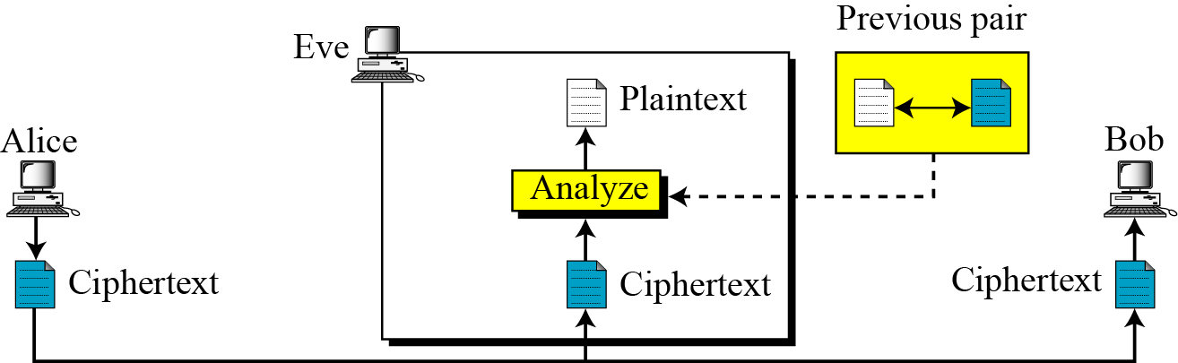
Known-Plaintext Attack
Attacker has access some previous plaintext/ciphertext pairs
  Assumption: No change of key
  Assumption: receiver made the ciphertext public
  Easier to implement
  Less likely to happen:
    Key may be changed
    May not disclose the content of previous messages
B C Dhara, Dept. of IT, JU

Slide 23
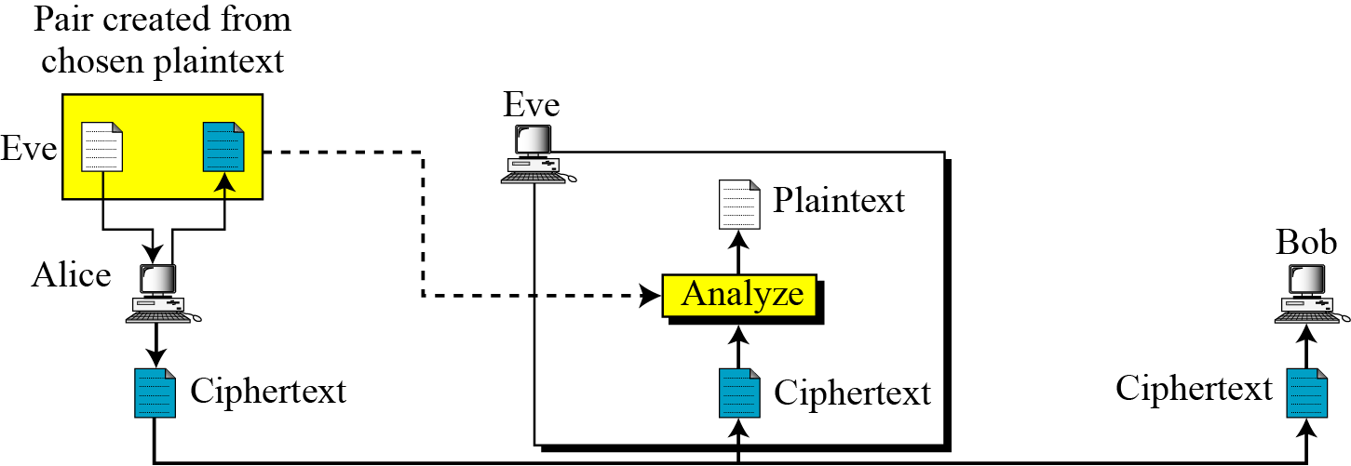
Chosen-Plaintext Attack
Plaintext/ciphertext pairs have been selected by attacker
  Attacker can access the machine of sender
It is less likely to happen
An adaptive chosen-plaintext attack is a chosen-plaintext attack wherein the choice of plaintext may depend on the ciphertext received from previous requests.
B C Dhara, Dept. of IT, JU

Slide 24
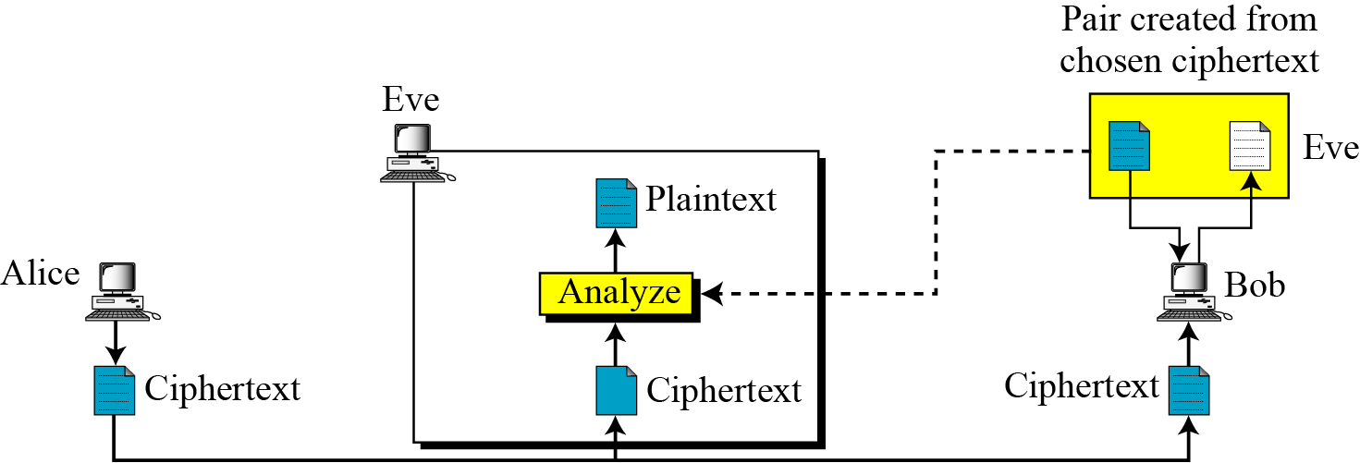
Chosen-Ciphertext Attack
Attacker selects ciphertext/plaintext pairs
  Attacker can access the machine of receiver
An adaptive chosen-ciphertext attack is a chosen-ciphertext attack where the choice of ciphertext may depend on the plaintext received from previous requests.
B C Dhara, Dept. of IT, JU

Slide 25
Traditional cipher techniques
Traditional symmetric-key ciphers are broadly categorized into two groups:
  Substitution ciphers
  Transposition ciphers
B C Dhara, Dept. of IT, JU

Slide 26
SUBSTITUTION CIPHERS
A substitution cipher replaces one symbol with another.
  Substitution ciphers can be categorized as either monoalphabetic ciphers or polyalphabetic ciphers.
A substitution cipher replaces one symbol with another.
B C Dhara, Dept. of IT, JU

Slide 27
Monoalphabetic Ciphers
In monoalphabetic substitution, the relationship between a symbol in the plaintext to a symbol in the ciphertext is always one-to-one.
B C Dhara, Dept. of IT, JU

Slide 28
Monoalphabetic Ciphers (contd…)
Example: The following shows a plaintext and its corresponding ciphertext. The cipher is probably monoalphabetic because both l’s (els) are encrypted as O’s
  Plaintext: hello Ciphertext: KHOOR
Example: The following shows a plaintext and its corresponding ciphertext. The cipher is not monoalphabetic because each l (el) is encrypted by a different character
  Plaintext: hello Ciphertext: ABNZF
B C Dhara, Dept. of IT, JU

Slide 29
Monoalphabetic Cipher Security
A total of 26! = 4 x 10²⁶ keys
So many keys, might think is secure
but would be !!!WRONG!!!
problem is language characteristics
B C Dhara, Dept. of IT, JU

Slide 30
Language Redundancy and Cryptanalysis
human languages are redundant
letters are not equally used
in English E is by far the most common letter
  followed by T,R,N,I,O,A,S
other letters like Z,J,K,Q,X are fairly rare ave tables of single, double & triple letter frequencies for various languages
B C Dhara, Dept. of IT, JU

Slide 31

English Letter Frequencies
B C Dhara, Dept. of IT, JU

Slide 32
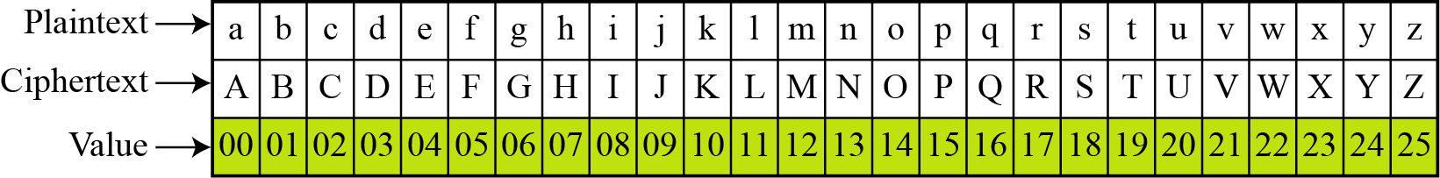
Additive cipher
The simplest monoalphabetic cipher is the additive cipher
  This cipher is sometimes called a shift cipher and sometimes a Caesar cipher, but the term additive cipher better reveals its mathematical nature.
B C Dhara, Dept. of IT, JU

Slide 33
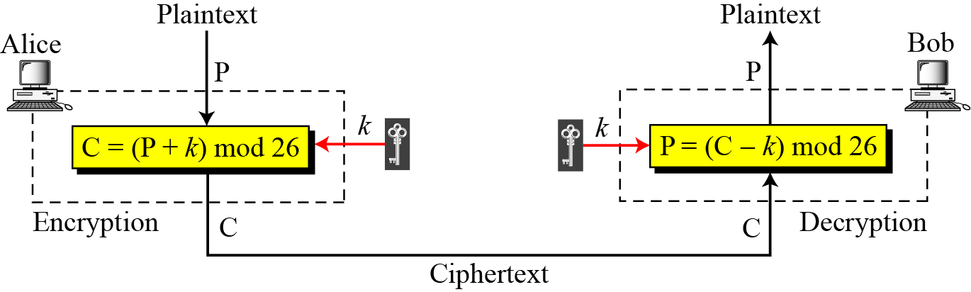
Additive cipher (contd…)
When the cipher is additive, the plaintext, ciphertext, and key are integers in Z₂₆.
C= (P+k) mod 26
P1=(C-k) mos 26 =(P+k-k) mod 26 = P
B C Dhara, Dept. of IT, JU

Slide 34
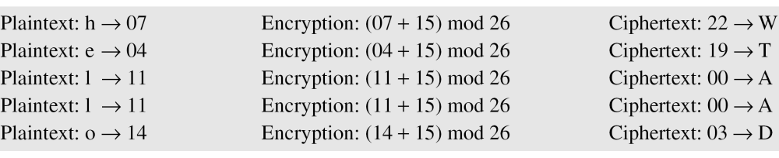
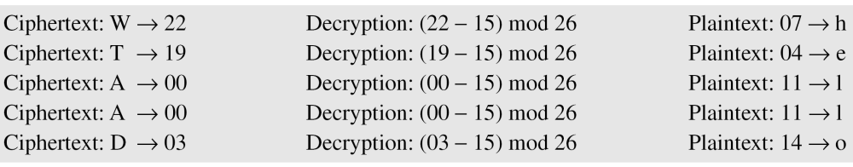
Additive cipher (contd…)
Use the additive cipher with k = 15 for “hello” ⬅➔ “WTAAD”.
B C Dhara, Dept. of IT, JU

Slide 35
It is important to make sure that modulo operation will return non-negative integer.
B C Dhara, Dept. of IT, JU

Slide 36
Additive cipher (contd…)
Historically, additive ciphers are called shift ciphers
  Julius Caesar used an additive cipher to communicate with his officers
  For this reason, additive ciphers are sometimes referred to as the Caesar cipher
    Caesar used a key of 3 for his communications.
Additive ciphers are sometimes referred to as shift ciphers or Caesar cipher.
B C Dhara, Dept. of IT, JU

Slide 37
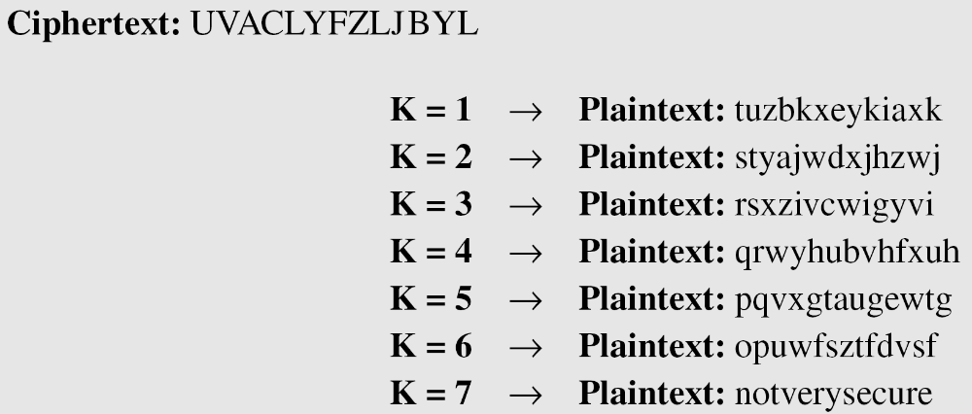
Attack to additive cipher
Additive cipher is vulnerable to the ciphertext-only attack
  Since key space is very small, exhaustive search (brute force attack)
  K=0 has no effect, so only 25 possible keys
Attacker has intercepted the ciphertext “UVACLYFZLJBYL”. Show how she can use a brute-force attack to break the cipher.
B C Dhara, Dept. of IT, JU

Slide 38
Statistical attack on additive cipher
Long sequence of ciphertext is available
Frequency of individual characters are used
Sometimes characters pattern (i.e., a group of consecutive characters) is also important
  Two-letter groups (diagrams), three-letter groups (trigrams)
B C Dhara, Dept. of IT, JU

Slide 39
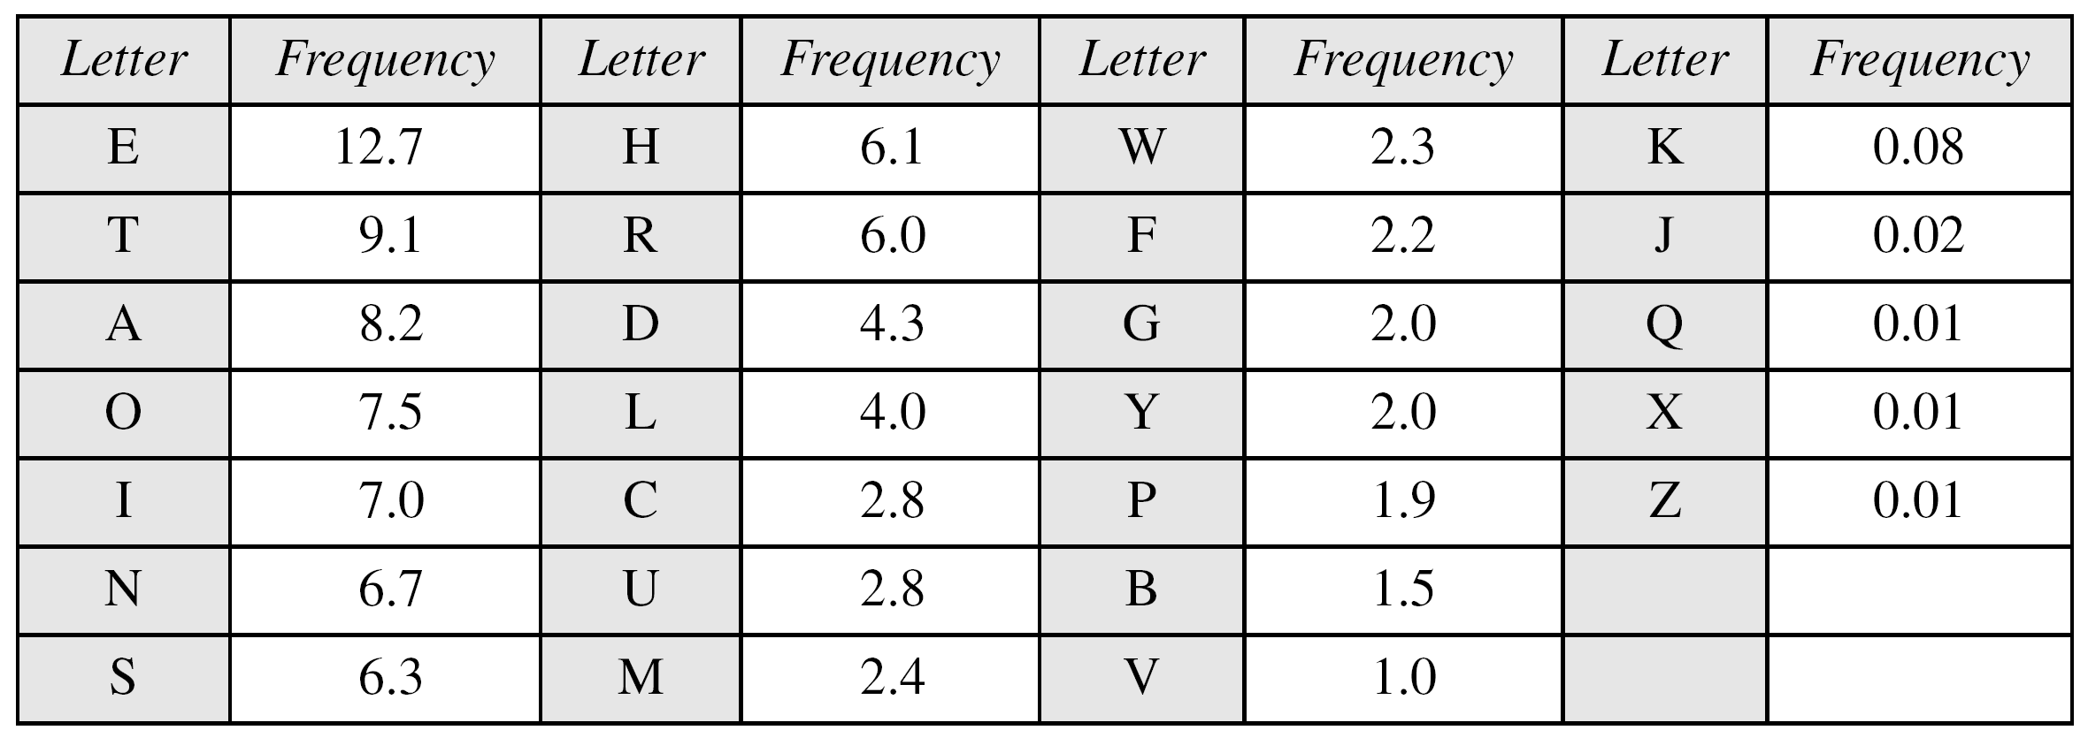
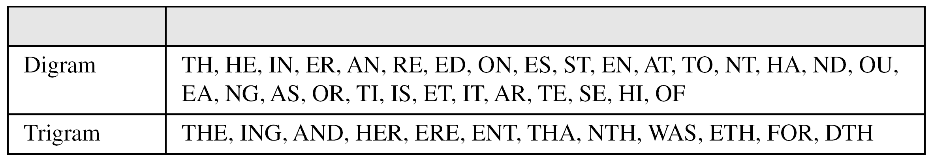
Frequency tables
B C Dhara, Dept. of IT, JU

Slide 40
Statistical attack on additive cipher (cont…)
Attacker has intercepted the following ciphertext. Using a statistical attack, find the plaintext
When tabulates the frequency of letters in this ciphertext,
  The most common character is I with 14 occurrences. This means key = -4.
B C Dhara, Dept. of IT, JU

Slide 41
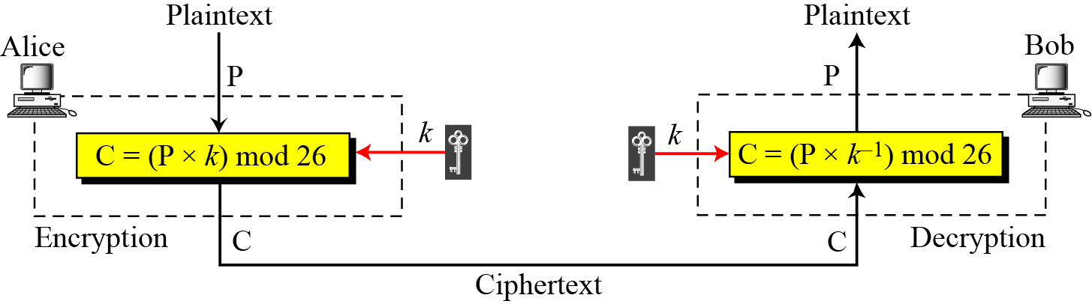
Multiplicative Ciphers
In a multiplicative cipher, the plaintext and ciphertext are integers in Z₂₆;
  the key is an integer in Z₂₆*, due to the multiplicative inverse
P = (C × k⁻¹) mod 26
B C Dhara, Dept. of IT, JU

Slide 42
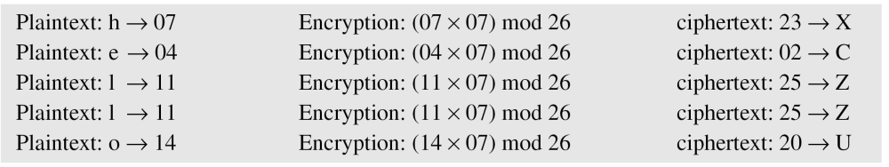
Multiplicative Ciphers (contd…)
What is the key domain for any multiplicative cipher?
  The key needs to be in Z₂₆*. This set has only 12 members: {1, 3, 5, 7, 9, 11, 15, 17, 19, 21, 23, 25}
We use a multiplicative cipher to encrypt the message “hello” with a key of 7. The ciphertext is “XCZZU”.
B C Dhara, Dept. of IT, JU

Slide 43
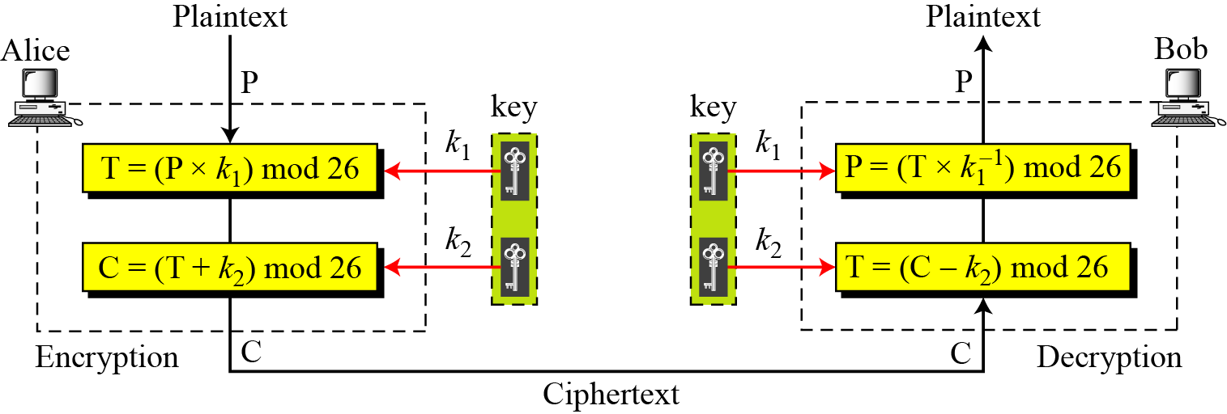
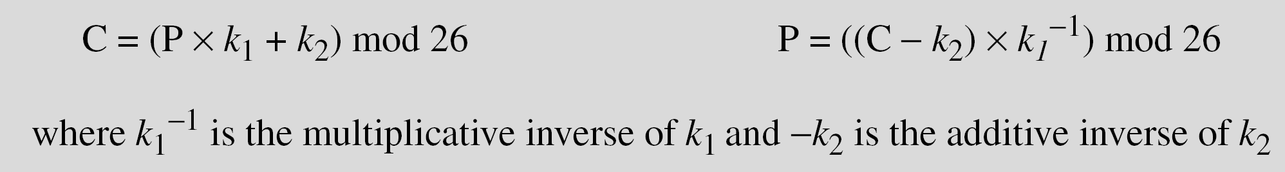
Affine cipher
A combination of additive and multiplicative ciphers
B C Dhara, Dept. of IT, JU

Slide 44
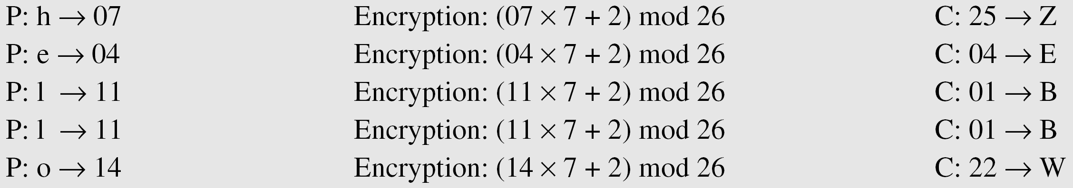
Affine cipher (cont…)
The affine cipher uses a pair of keys in which the first key is from Z₂₆* and the second is from Z₂₆. The size of the key domain is 26 × 12 = 312
Use an affine cipher to encrypt the message “hello” with the key pair (7, 2)
B C Dhara, Dept. of IT, JU

Slide 45
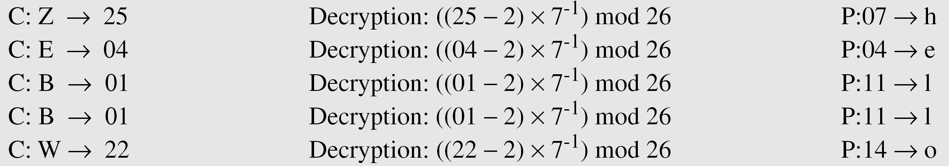
Affine cipher (cont…)
Use the affine cipher to decrypt the message “ZEBBW” with the key pair (7, 2) in modulus 26.
The additive cipher is a special case of an affine cipher in which k₁ = 1
The multiplicative cipher is a special case of affine cipher in which k₂ = 0
B C Dhara, Dept. of IT, JU

Slide 46
Cryptanalysis to Affine cipher
Ciphertext-only attack like brute-force attack, statistical attack can be used
Now, chosen-plaintext attack is considered
Ciphertext: PWUFFOGWCHFDIWEJOUUNJORSMDWRHVCMWJUPVCCG
Two-letter plaintext “et”, two encryption algorithms (with different k₁ and k₂)
i) plaintext: et → ciphertext: WC
ii) plaintext: et → ciphertext: WF
B C Dhara, Dept. of IT, JU

Slide 47
Cryptanalysis to Affine cipher (cont…)
i) e → W ➔ 04 →22 and t →C ➔ 19 →02
04 × k₁ + k₂ ≡ 22 (mod 26)
19 × k₁ + k₂ ≡ 02 (mod 26)
k₁ =16 and k₂ =10, but k₁ ∉ Z₂₆*, not possible
B C Dhara, Dept. of IT, JU

Slide 48
Cryptanalysis to Affine cipher (cont…)
ii) e → W ➔ 04 →22 and t →F ➔ 19 →05
04 × k₁ + k₂ ≡ 22 (mod 26)
19 × k₁ + k₂ ≡ 05 (mod 26)
k₁ =11 and k₂ =4, this pair acceptable as k₁ ∈ Z₂₆*
Encryption key pair is (11,4) and decryption key pair is (19, 22) and plaintext is
best time of the year is spring when flowers bloom
B C Dhara, Dept. of IT, JU

Slide 49
Monoalphabetic Substitution Cipher
Because additive, multiplicative, and affine ciphers have small key domains, they are very vulnerable to brute-force attack
A better solution is to create a mapping between each plaintext character and the corresponding ciphertext character
  A table showing the mapping for each character
B C Dhara, Dept. of IT, JU

Slide 50
Monoalphabetic Substitution Cipher (cont…)
Use the key in previous table to encrypt the message, this message is easy to encrypt but hard to find the key
The ciphertext is
B C Dhara, Dept. of IT, JU

Slide 51
Monoalphabetic Substitution Cipher (cont…)
The size of key space for the monoalphabetic cipher is 26!
  Brute-force attack is extremely difficult
Monoalphabetic ciphers do not change the frequency of characters in the ciphertext
  Which makes the ciphers vulnerable to statistical attack
Affine cipher is a special case of substitution cipher with only 26 x 12 possible keys instead of 26! keys.
B C Dhara, Dept. of IT, JU

Slide 52
Polyalphabetic Ciphers
In polyalphabetic substitution, each occurrence of a character may have a different substitute.
  The relationship between a character in the plaintext to a character in the ciphertext is one-to-many
  This technique hides the letter frequency of the underlying language
  Single-letter statistics cannot be used to break the ciphertext
B C Dhara, Dept. of IT, JU

Slide 53
Polyalphabetic Ciphers (cont…)
  Ciphertext character depends on the corresponding plaintext and position of the plaintext character in the message
  A key stream k=(k₁, k₂, ….) in which k_{i} is used to encipher the i^{th} character in the plaintext to create i^{th} character in the ciphertext
B C Dhara, Dept. of IT, JU

Slide 54
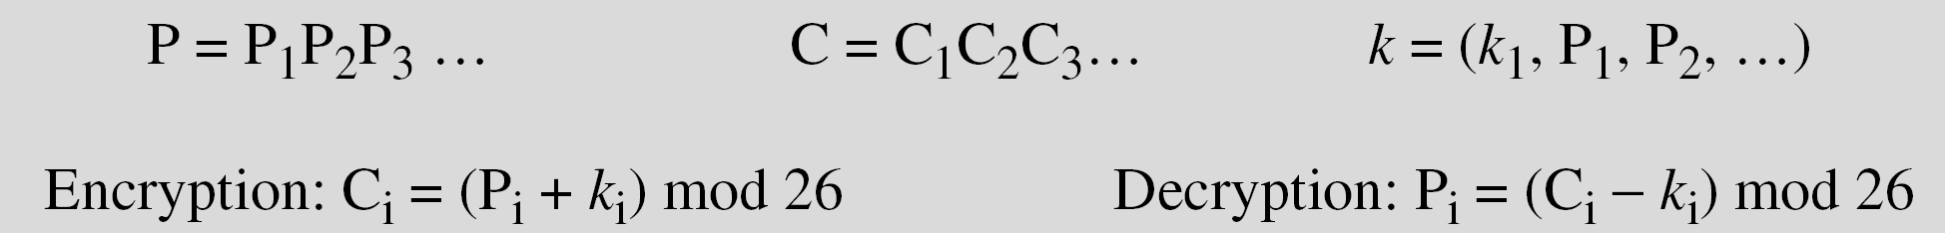
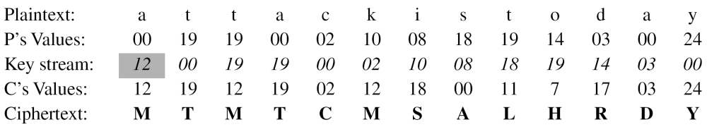
Autokey cipher
Consider an autokey cipher with initial key value k1 = 12. Encipher the message “Attack is today”
B C Dhara, Dept. of IT, JU

Slide 55
Cryptanalysis on Autokey cipher
It is vulnerable to the brute-force attack
  since first subkey can be only one of the 25 values (1 to 25)
  Ciphers should have large key domains
B C Dhara, Dept. of IT, JU

Slide 56
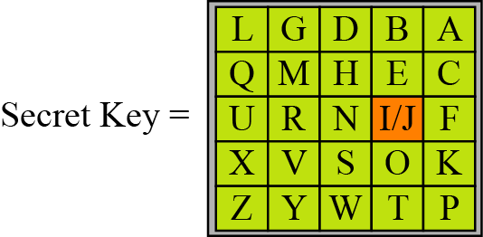
Playflair cipher
Used during World War I
Secret key is of 25 alphabets stored in 5x5 matrix
Different arrangements of the letters create many secret keys
B C Dhara, Dept. of IT, JU

Slide 57
Playflair cipher (contd…)
A message string is encrypted using the following logic:
Consider two letters at a time
If a pair with same two letters are not considered
  If appears, an auxiliary symbol is inserted between them
If length of the string is odd, one auxiliary symbol is inserted at the end to make the string of length even
B C Dhara, Dept. of IT, JU

Slide 58
Playflair cipher (contd…)
Consider group of two letters from the pre-processed message string
If both letters appear on the same row of the secret key matrix
  Cipher letter for each letter is the next letter to the right in the same row with wrapping to beginning of the row
If both letters appear on the same column of the secret key matrix
  Cipher letter for each letter is the next letter to the beneath in the column with wrapping to beginning of the column
If two pair letters are not in the same row or column
  Cipher letters are at the row-column intersection points (with row priority)
B C Dhara, Dept. of IT, JU

Slide 59
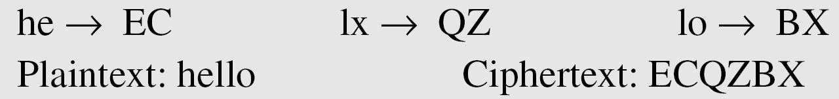
Example of Playflair cipher
Let us encrypt the plaintext “hello” using the above key matrix
B C Dhara, Dept. of IT, JU

Slide 60
Notes on Playflair cipher
Auxiliary letter should be something from {26,27,28,29,30,31} as letters are represented by {0,1,2,…,25}
Auxiliary symbols are
of two types:
i) as the separator for
‘xx’, and
ii) separator for ‘IJ’ or ‘JI’
B C Dhara, Dept. of IT, JU

Slide 61
Cryptanalysis of Playfair cipher
Brute-force attacke is very difficult
Encipherment hides the signle-letter frequency
Frequencies of diagrams are preserved (some change due to filler insertion)
  An attacker can use ciphertext-only attack based on diagram frequency test to find the key
B C Dhara, Dept. of IT, JU

Slide 62
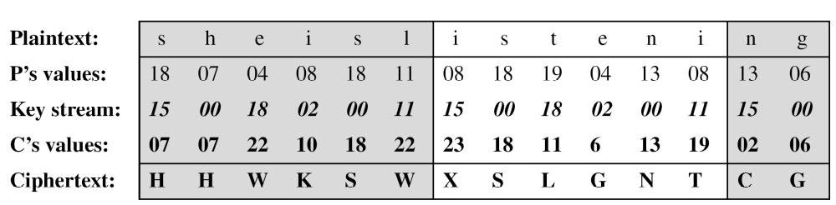
Vigenere Cipher
We can encrypt the message “She is listening” using the 6-character keyword “PASCAL”.
B C Dhara, Dept. of IT, JU

Slide 63
Vigenere Cipher (contd …)
Vigenere key stream does not depend on the plaintext characters
It depends only on the position of the character in the plaintext
  Key stream can be created without knowing the plaintext
B C Dhara, Dept. of IT, JU

Slide 64
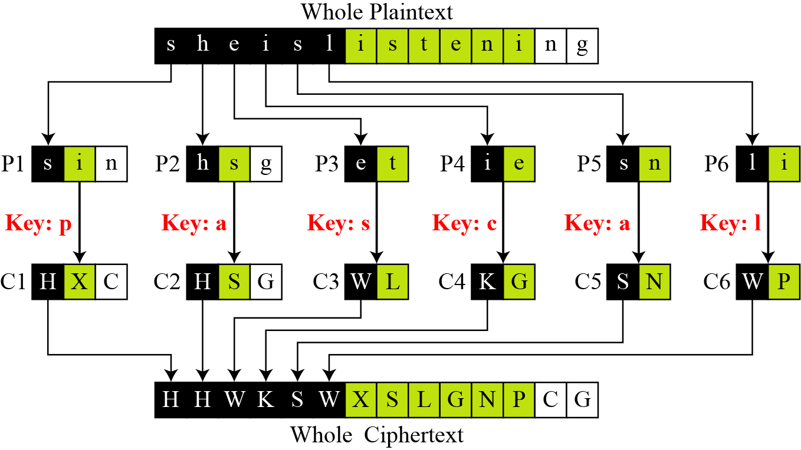
Vigenere Cipher (contd …)
Vigenere cipher can be seen as combinations of m additive ciphers.
B C Dhara, Dept. of IT, JU

Slide 65
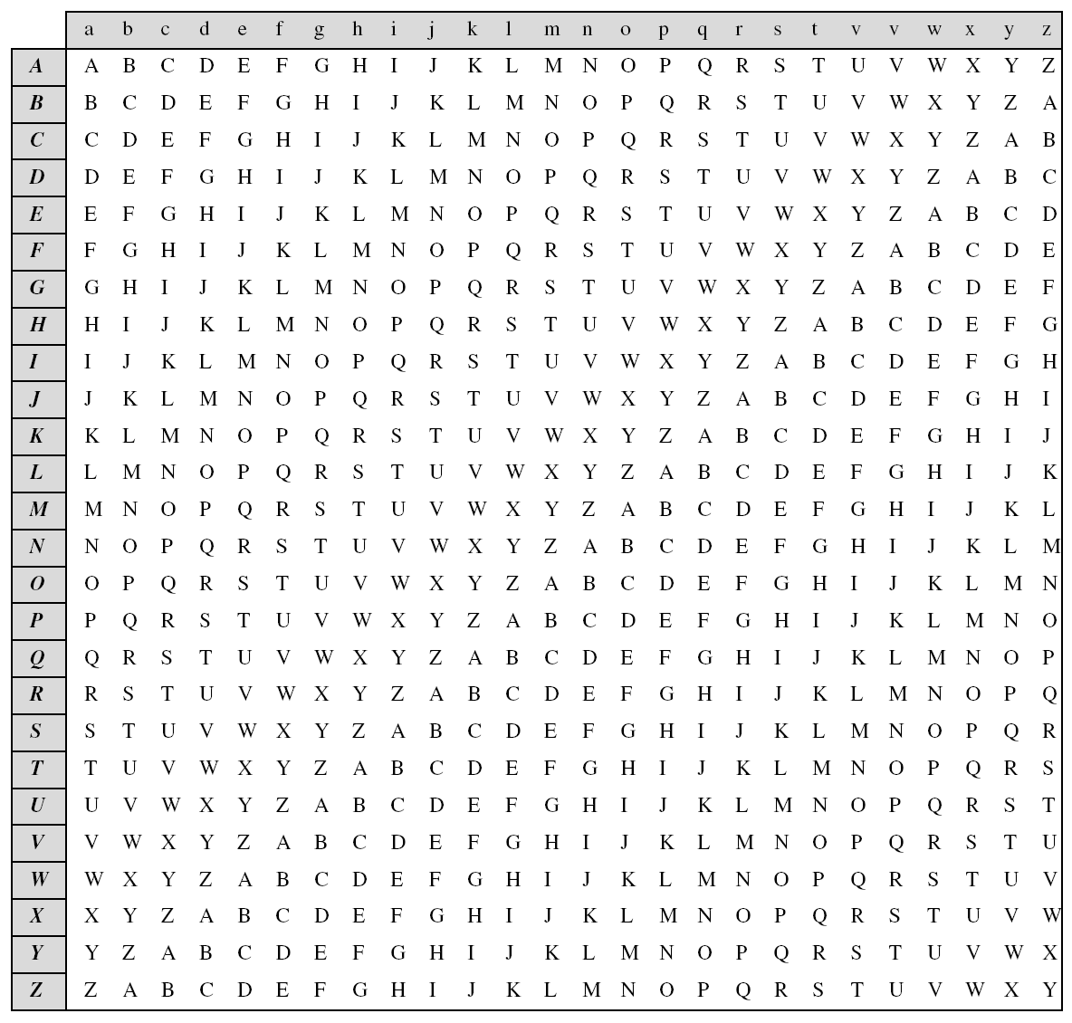
Vigenere Cipher (contd …)
Additive cipher is a special case of Vigenere cipher in which m = 1
B C Dhara, Dept. of IT, JU

Slide 66
Cryptanalysis of Vigenere cipher
Vigenere cipher does not preserve the frequency of characters
Cryptanalysis consists of two parts:
  Finding the key length
  Finding the key itself
B C Dhara, Dept. of IT, JU

Slide 67
Cryptanalysis of Vigenere cipher (contd…)
Kasiski test
  Find repeated text segment, of length at least three, in the ciphertext
  Suppose, two segments found and distance between them is d
    d| m, m the length of the key
  If more repeated segments found with distances d₁, d₂,…,d_{n} , then gcd(d₁, d₂,…,d_{n} ) | m
When length of key is found,
  Divides the ciphertext into m pieces and …
  If fails then divides the message into 2m pieces, …
B C Dhara, Dept. of IT, JU

Slide 68
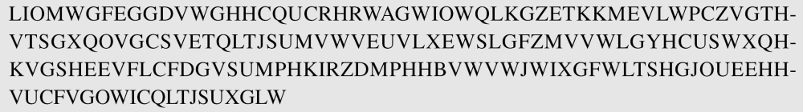
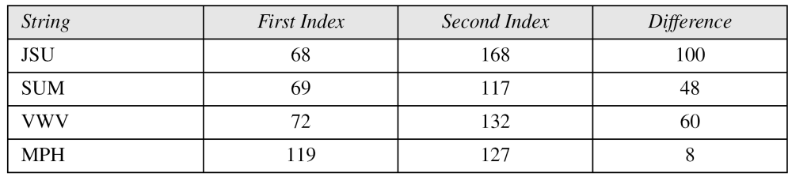
Vigenere Cipher (Crypanalysis)
Let us assume we have intercepted the following ciphertext:
The Kasiski test for repetition of three-character segments yields the results shown in the following Table
B C Dhara, Dept. of IT, JU

Slide 69
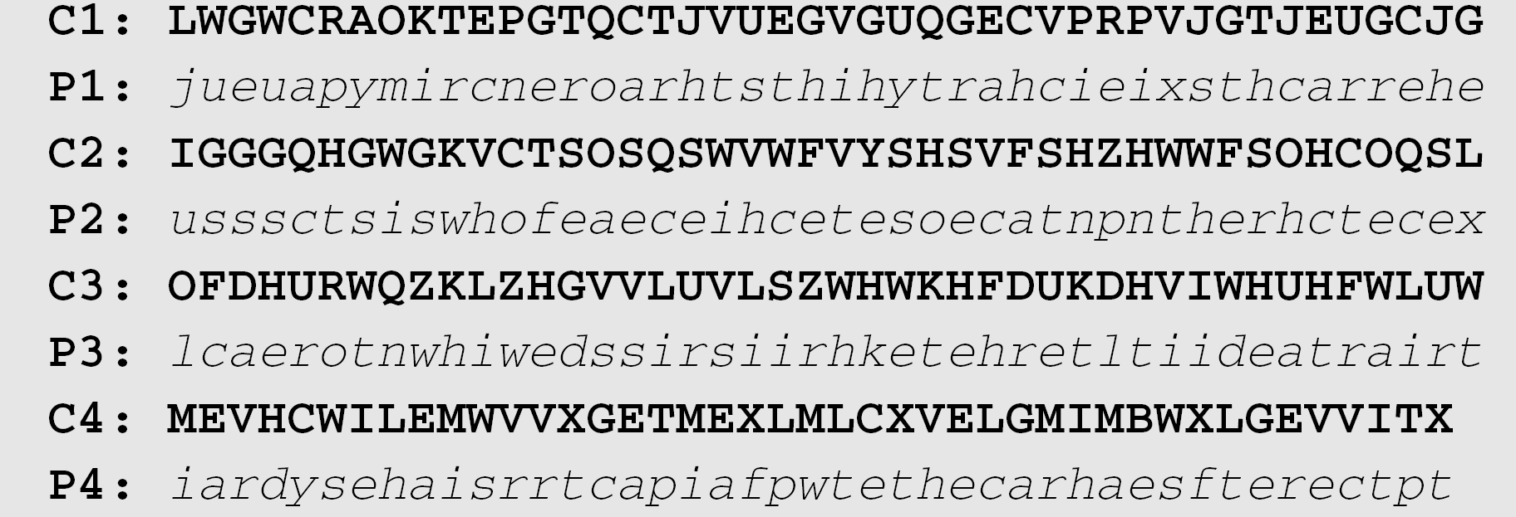
Vigenere Cipher (Crypanalysis) (contd…)
The greatest common divisor of differences is 4, which means that the key length is multiple of 4. First try m = 4.
B C Dhara, Dept. of IT, JU

Slide 70
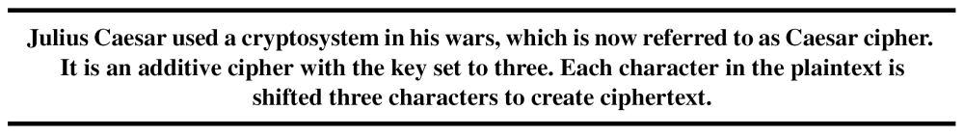
Vigenere Cipher (Crypanalysis) (contd…)
In this case, the plaintext makes sense.
B C Dhara, Dept. of IT, JU

Slide 71
Hill cipher
Divides the plaintext into equal-size blocks
Blocks are encrypted one at a time in such a way that each character in the block contributes to the encryption of other character in the block
  This is block cipher
Key is a square matrix of size m × m, size of block is m
B C Dhara, Dept. of IT, JU

Slide 72
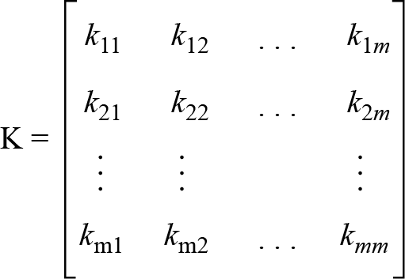
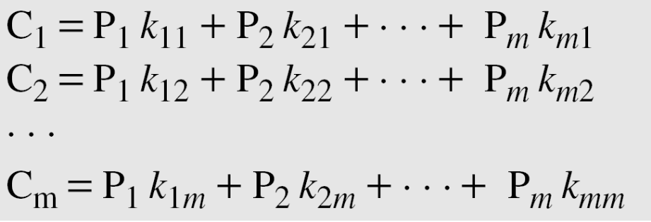
Hill cipher (contd…)
The key matrix in the Hill cipher needs to have a multiplicative inverse.
B C Dhara, Dept. of IT, JU

Slide 73
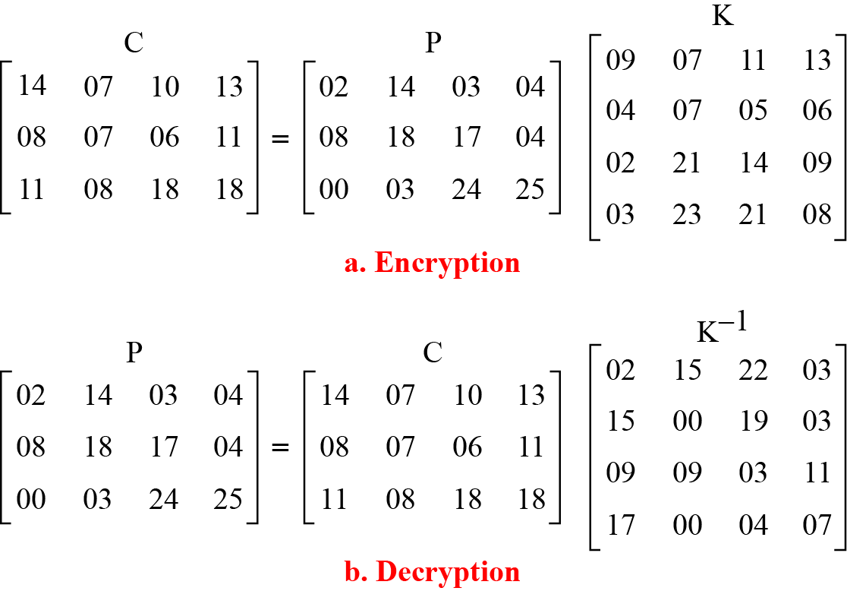
Hill cipher (contd…)
For example, the plaintext “code is ready” can make a 3 × 4 matrix when adding extra bogus character “z” to the last block and removing the spaces. The ciphertext is “OHKNIHGKLISS”
B C Dhara, Dept. of IT, JU

Slide 74
Cryptanalysis of Hill cipher
Ciphertext-only attack is difficult as:
  Brute-force attack is extremely difficult
    Since size of key matrix is m × m and in each location possibilities is 26
    Size of key space is 26^{m×m}
    Non-invertible matrices cannot be key
  This cipher does not preserve the statistics of the plaintext
    Frequency analysis on single letter, diagrams, trigrams will not work
    Frequency analysis on words of length m might work that plaintext has many words of length m that are same
B C Dhara, Dept. of IT, JU

Slide 75
Cryptanalysis of Hill cipher (contd…)
Attacker can execute known-plaintext attack if
  m is known
  At least m plaintext/ciphertext pairs are known (may be from same/different messages)
  Blocks must be distinct
    Two matrices of size m × m, P (plaintext) and C (ciphertext) and key is computed as K=CP⁻¹
    If P is not invertible, new set of m plaintext/ciphertext pairs are needed
B C Dhara, Dept. of IT, JU

Slide 76
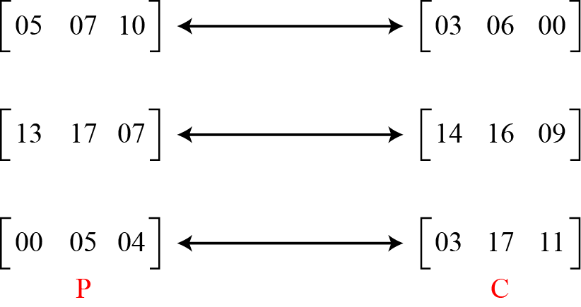
Cryptanalysis of Hill cipher: known-plaintext attack
Assume that attacker knows that m = 3 and intercepted three plaintext/ciphertext pair blocks (not necessarily from the same message)
B C Dhara, Dept. of IT, JU

Slide 77
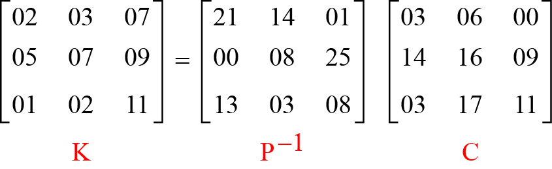
Cryptanalysis of Hill cipher: known-plaintext attack (contd…)
Matrices P and C are constructed from these pairs
  Because P is invertible, then inverts the P matrix and multiplies it by C to get the K matrix
Now the key and can break any ciphertext encrypted with that key
B C Dhara, Dept. of IT, JU

Slide 78
One-Time Pad
One of the goals of cryptography is perfect secrecy
A study by Shannon has shown that perfect secrecy can be achieved if each plaintext symbol is encrypted with a key randomly chosen from a key domain
This idea is used in a cipher called one-time pad, invented by Vernam
B C Dhara, Dept. of IT, JU

Slide 79
One-Time Pad (contd…)
In additive cipher,
  To encrypt each symbol a key randomly selected from {0,1,2,..,25} instead of a fixed key
  Ciphertext-only attack is impossible
One-time pad cipher, key has the same length as the plaintext
One-time pad is perfect
  But, almost impossible to implement it becaue
    How the keys will be communicated between sender and receiver?
B C Dhara, Dept. of IT, JU

Slide 80
TRANSPOSITION CIPHERS
Consider classical transposition or permutation ciphers
A transposition cipher does not substitute one symbol for another, instead it changes the location of the symbols
  Hide the message by rearranging the letter order without altering the actual letters used
Keyless Transposition Ciphers
Keyed Transposition Ciphers
Combining Two Approaches
B C Dhara, Dept. of IT, JU

Slide 81
Keyless Transposition Ciphers
Simple transposition ciphers, which were used in the past, are keyless.
B C Dhara, Dept. of IT, JU

Slide 82
Rail fence cipher
Write message letters out diagonally over a number of rows
Then read off cipher row by row
For example, the message “Meet me at the park” is encipher as follows
The ciphertext is “MEMATEAKETETHPR”.
B C Dhara, Dept. of IT, JU

Slide 83
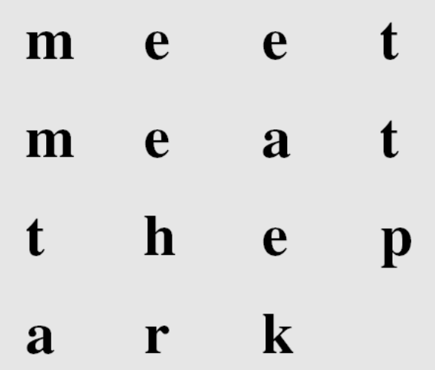
Keyless method: second method
The sender and receiver can agree on the number of columns and write the plaintext, row by row, in a table
Finally, ciphertext is constructed considering column wise letters
the ciphertext is “MMTAEEHREAEKTTP”
B C Dhara, Dept. of IT, JU

Slide 84
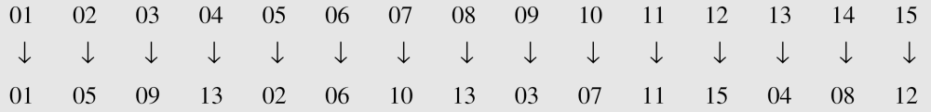
Keyless method: second method (contd…)
The cipher is achieved by permutation of each character in the plaintext into the ciphertext based on the positions
1
2
3
4
5
B C Dhara, Dept. of IT, JU

Slide 85
Keyed Transposition Ciphers
The keyless ciphers permute the characters by using writing plaintext in one way and reading it in another way
The permutation is done on the whole plaintext to create the whole ciphertext
Another method is to divide the plaintext into groups of predetermined size, called blocks, and then use a key to permute the characters in each block separately
B C Dhara, Dept. of IT, JU

Slide 86
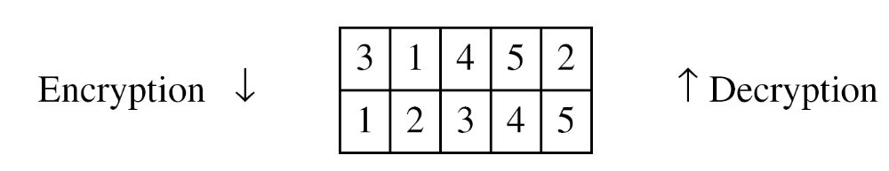
Keyed Transposition Ciphers (cont…)
Send the message “Enemy attacks tonight”
The key used for encryption and decryption is a permutation key, which shows how the character are permuted
The permutation yields
B C Dhara, Dept. of IT, JU

Slide 87
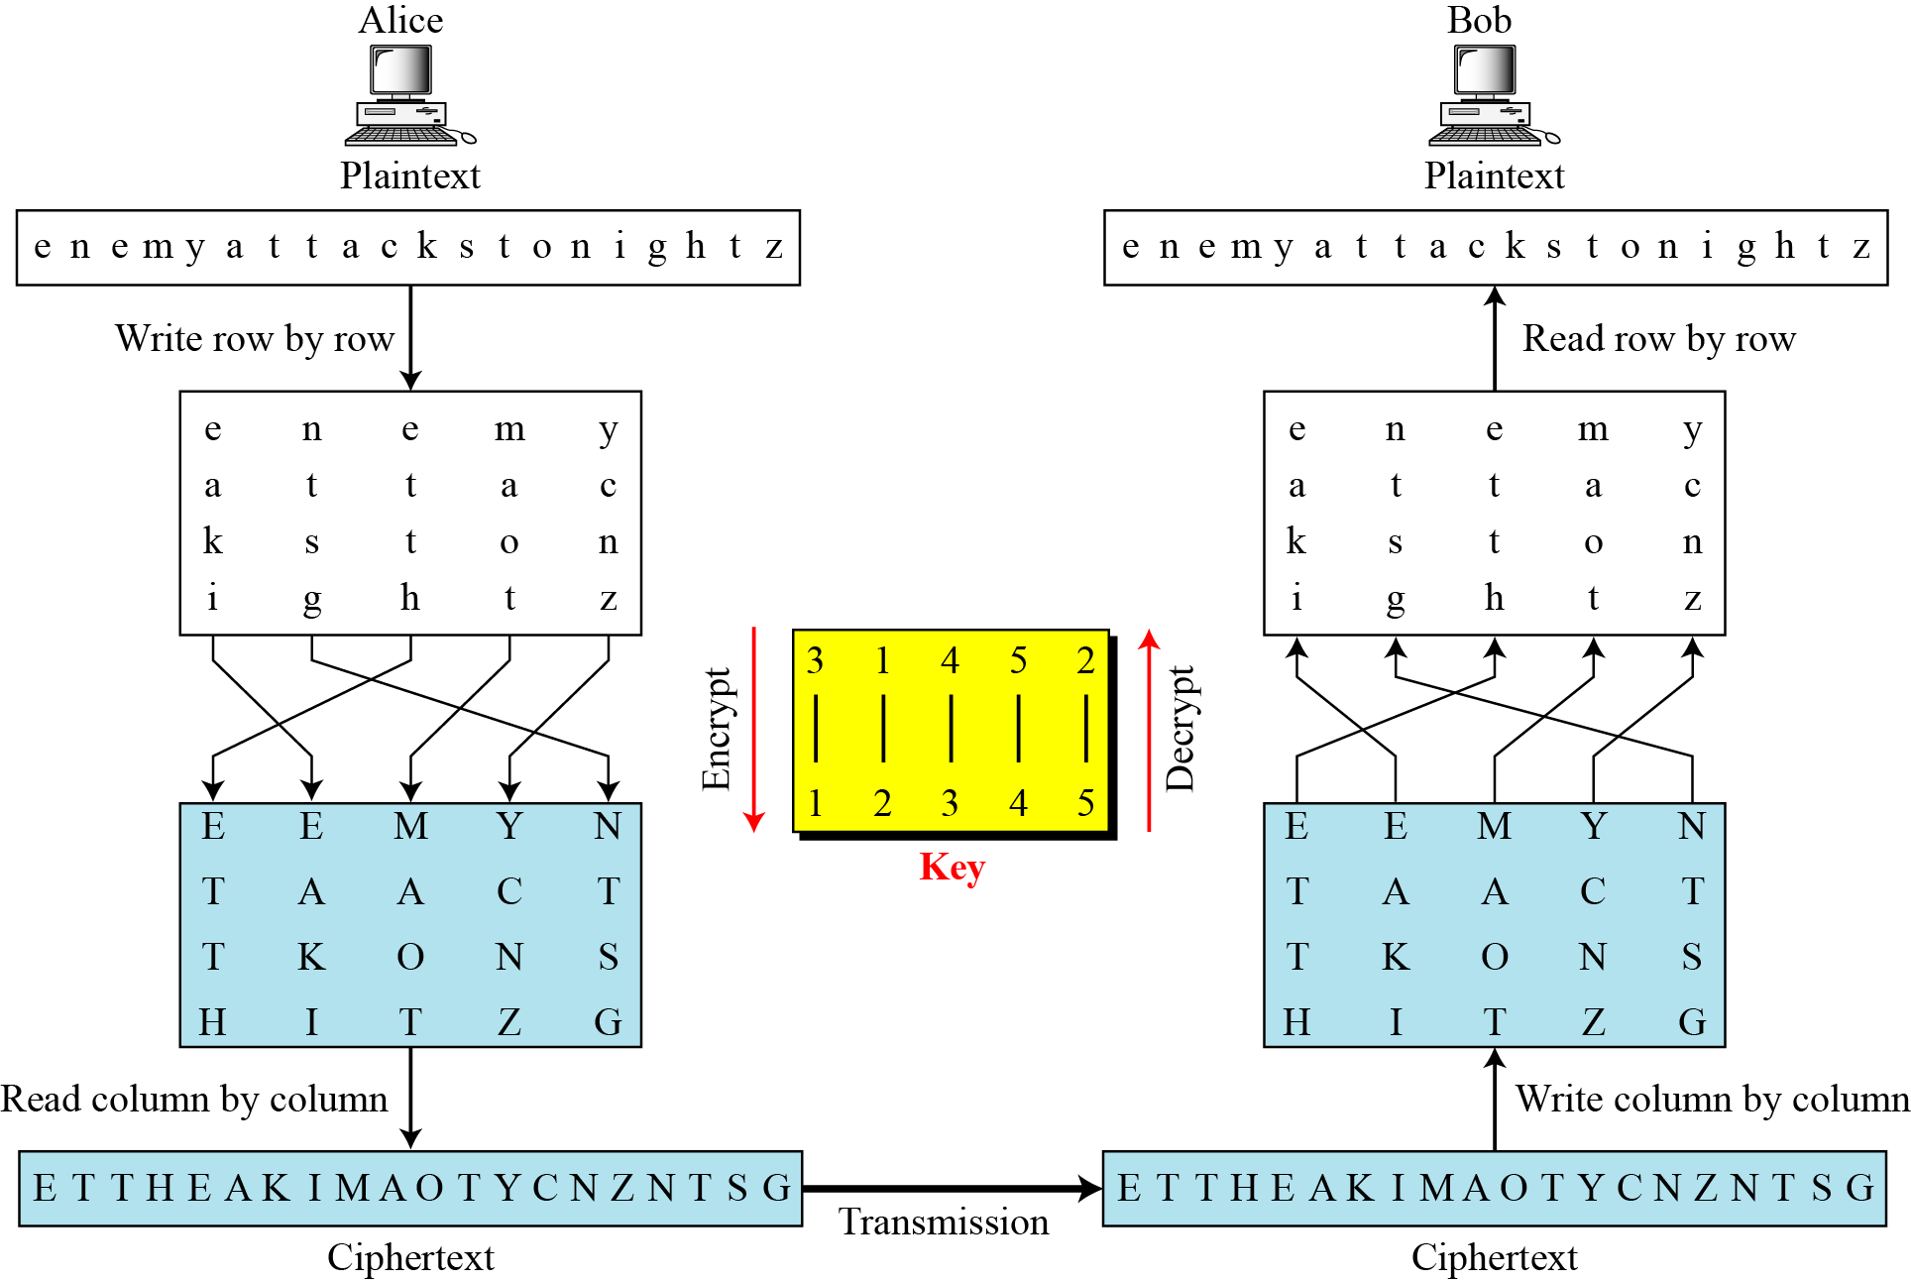
Combining Two Approaches
Step 1 keyless
Step 2: Keyed
Step 3: keyless
B C Dhara, Dept. of IT, JU

Slide 88
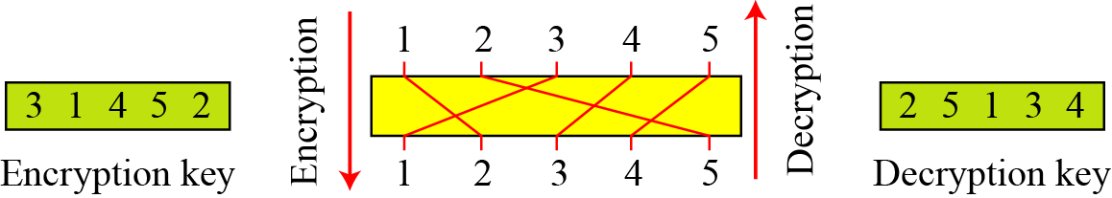
Representation of permutation
Representation of permutation in encryption and decryption
B C Dhara, Dept. of IT, JU

Slide 89
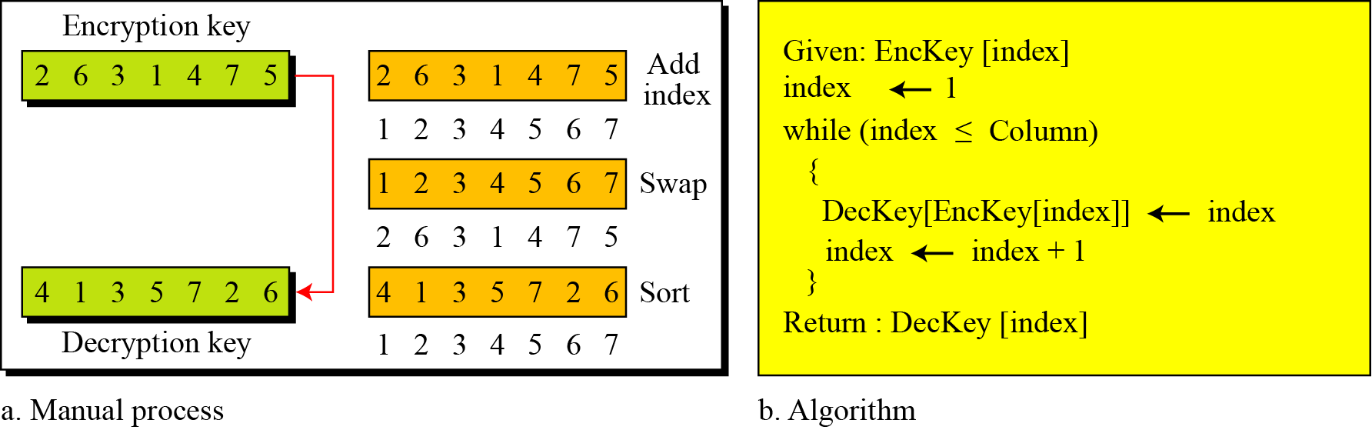
How the decryption key can be computed, if encryption key given?
B C Dhara, Dept. of IT, JU

Slide 90
Use of matrix in transposition
The encryption/decryption process for a transposition cipher can be accomplished using matrix multiplications
  The permutation of rows/columns can be executed by multiplication with permutation matrix
  Plaintext/ciphertext matrix are n×m and permutation matrix is m×m
B C Dhara, Dept. of IT, JU

Slide 91
Permutation matrix
Obtained from an identity matrix, by swapping rows or columns
In each row/cloumn, exactly one 1 and rest are 0s
Determinant is ±1, nonsingular
AA^{t} =I
  A^{t} is the inverse of A
B C Dhara, Dept. of IT, JU

Slide 92
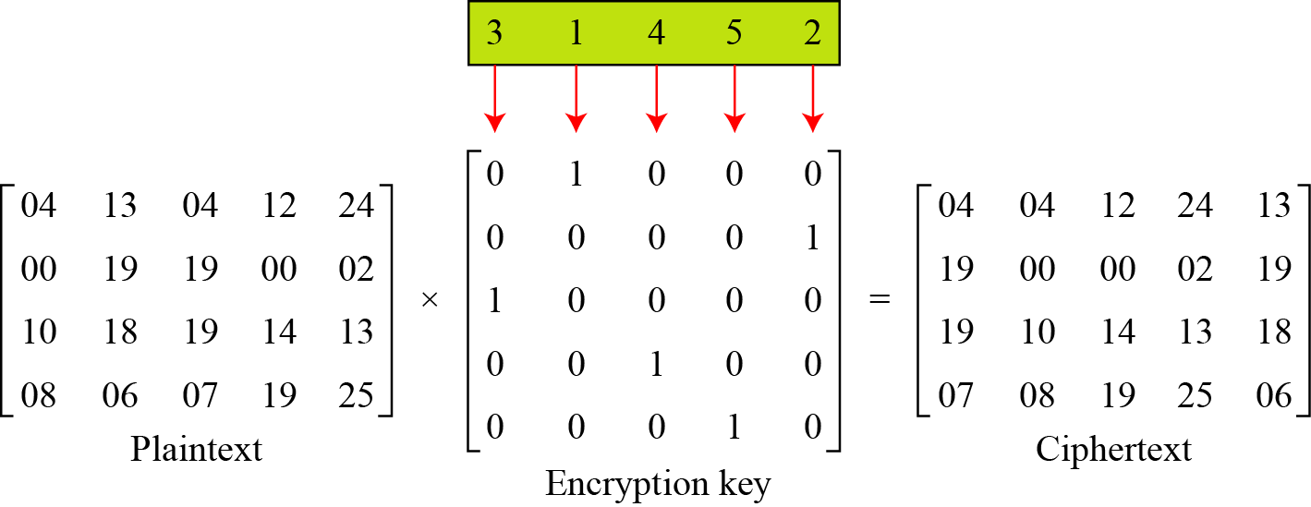
Use of matrix in transposition: example
The encryption process
  Multiplying the 4 × 5 plaintext matrix by the 5 × 5 encryption key gives the 4 × 5 ciphertext matrix
B C Dhara, Dept. of IT, JU

Slide 93
Cryptanalysis of Transposition ciphers
Transposition ciphers are vulnerable to ciphertext-only attacks
Statistical attacks
  No change in frequency of letters in ciphertext
  Single letter frequency analysis is useful if long length ciphertext is available
  Does not preserve the frequency of diagram and tridiagram
B C Dhara, Dept. of IT, JU

Slide 94
Cryptanalysis of Transposition ciphers (contd…)
Brute-Force attacks
  message length L
  Partition the message into columns
    Number of columns divides L
    E.g., if message length L=20, then possible number of columns: 1, 2, 4, 5, 10, 20
    only one column is not useful
    try with all possible columns and within which all possible permutations
B C Dhara, Dept. of IT, JU

Slide 95
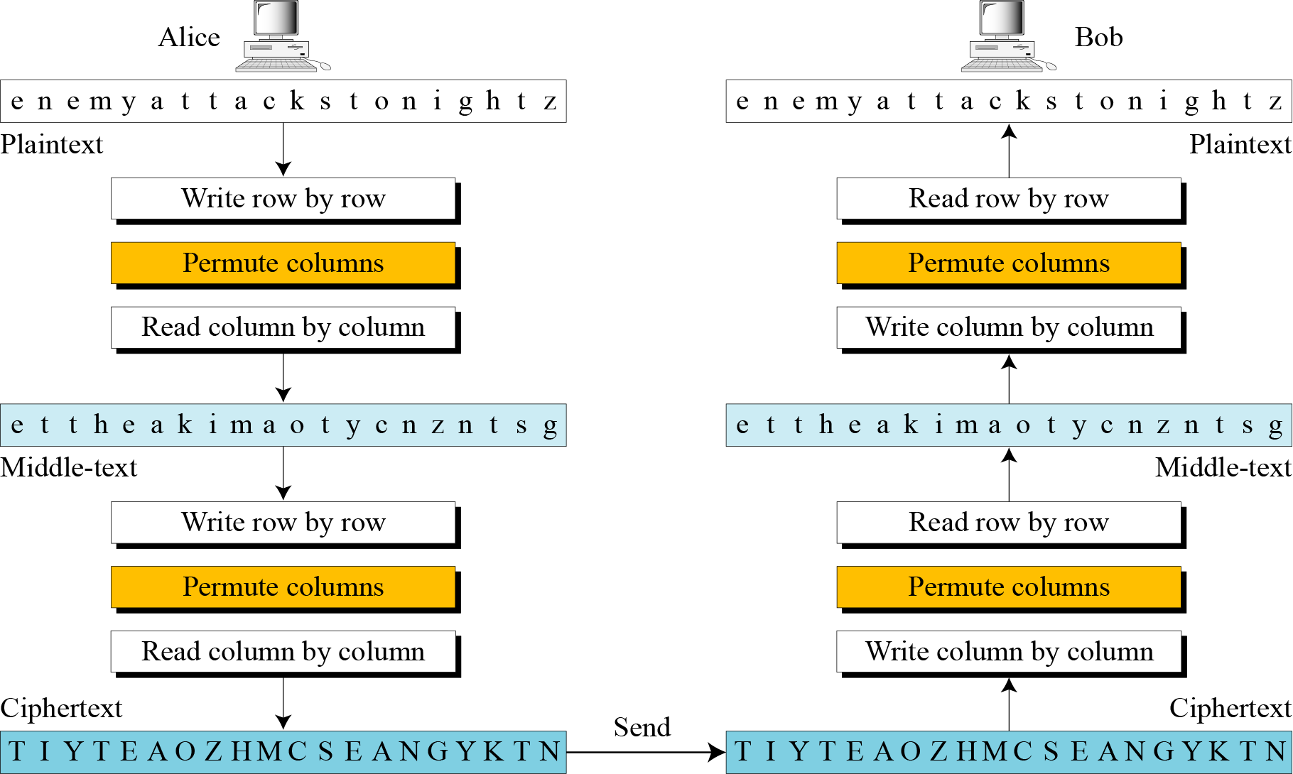
Double Transposition Ciphers
To make cryptanalysis task difficult: apply the transposition twice, with different keys (normally same key is used)
B C Dhara, Dept. of IT, JU

Slide 96
STREAM AND BLOCK CIPHERS
The literature divides the symmetric ciphers into two broad categories: stream ciphers and block ciphers
  Stream Ciphers
  Block Ciphers
  Combination
B C Dhara, Dept. of IT, JU

Slide 97
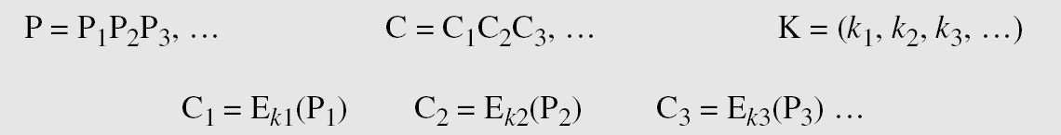
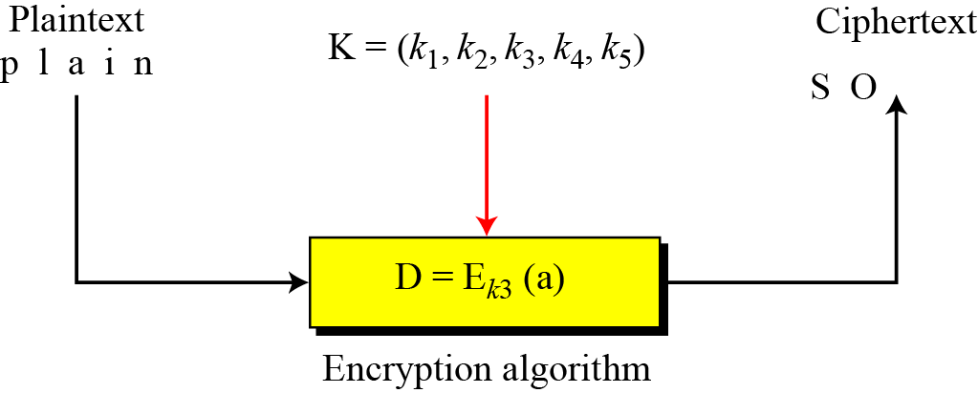
Stream Ciphers
Call the plaintext stream P, the ciphertext stream C, and the key stream K.
B C Dhara, Dept. of IT, JU

Slide 98
Stream Ciphers (contd…)
Key stream:
  It may be a stream of predefined values
  May be created one value at a time using an algorithm
  Values may depend on the plaintext or ciphertext characters
  Values may aldo depend on the previous values
B C Dhara, Dept. of IT, JU

Slide 99
Stream Ciphers examples
Additive ciphers can be categorized as stream ciphers in which the key stream is the repeated value of the key. In other words, the key stream is considered as a predetermined stream of keys or
K = (k, k, …, k). In this cipher, however, each character in the ciphertext depends only on the corresponding character in the plaintext, because the key stream is generated independently.
The monoalphabetic substitution ciphers discussed in this chapter are also stream ciphers. However, each value of the key stream in this case is the mapping of the current plaintext character to the corresponding ciphertext character in the mapping table.
B C Dhara, Dept. of IT, JU

Slide 100
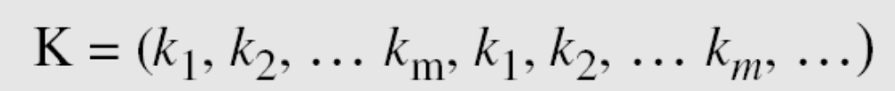
Stream Ciphers examples (contd…)
Vigenere ciphers are also stream ciphers according to the definition. In this case, the key stream is a repetition of m values, where m is the size of the keyword. In other words,
We can establish a criterion to divide stream ciphers based on their key streams. We can say that a stream cipher is a monoalphabetic cipher if the value of k_{i} does not depend on the position of the plaintext character in the plaintext stream; otherwise, the cipher is polyalphabetic.
B C Dhara, Dept. of IT, JU

Slide 101
Stream Ciphers examples (contd…)
Additive ciphers are definitely monoalphabetic because k_{i} in the key stream is fixed; it does not depend on the position of the character in the plaintext.
Monoalphabetic substitution ciphers are monoalphabetic because k_{i} does not depend on the position of the corresponding character in the plaintext stream; it depends only on the value of the plaintext character.
Vigenere ciphers are polyalphabetic ciphers because k_{i} definitely depends on the position of the plaintext character. However, the dependency is cyclic. The key is the same for two characters m positions apart.
B C Dhara, Dept. of IT, JU

Slide 102
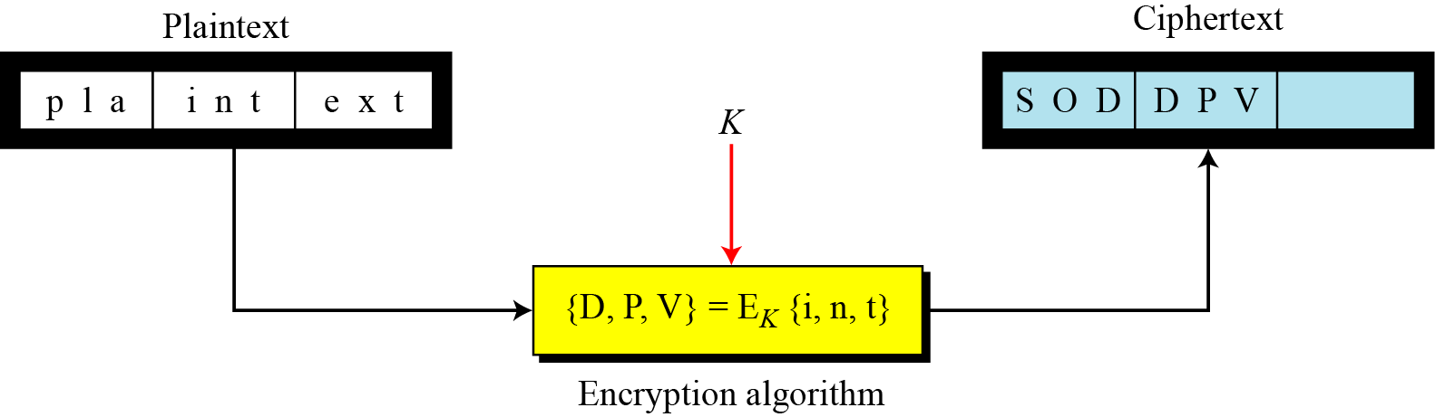
Block cipher
In a block cipher, a group of plaintext symbols of size m (m > 1) are encrypted together creating a group of ciphertext of the same size.
  A single key is used to encrypt the whole block even if the key is made of multiple values.
B C Dhara, Dept. of IT, JU

Slide 103
Block cipher example
Playfair ciphers are block ciphers. The size of the block is m = 2. Two characters are encrypted together.
Hill ciphers are block ciphers. A block of plaintext, of size 2 or more is encrypted together using a single key (a matrix). In these ciphers, the value of each character in the ciphertext depends on
all the values of the characters in the plaintext. Although the key is made of m × m values, it is considered as a single key.
From the definition of the block cipher, it is clear that every block cipher is a polyalphabetic cipher because each character in a ciphertext block depends on all characters in the plaintext block.
B C Dhara, Dept. of IT, JU

Slide 104
Combination of block/stream ciphers
In practice, blocks of plaintext are encrypted individually, but they use a stream of keys to encrypt the whole message block by block. In other words, the cipher is a block cipher when looking at the individual blocks, but it is a stream cipher when looking at the whole message considering each block as a single unit.
B C Dhara, Dept. of IT, JU

